Slide 1
melbourne or sydney
yifan yang

Slide 2


data
location data
venues data

Slide 3
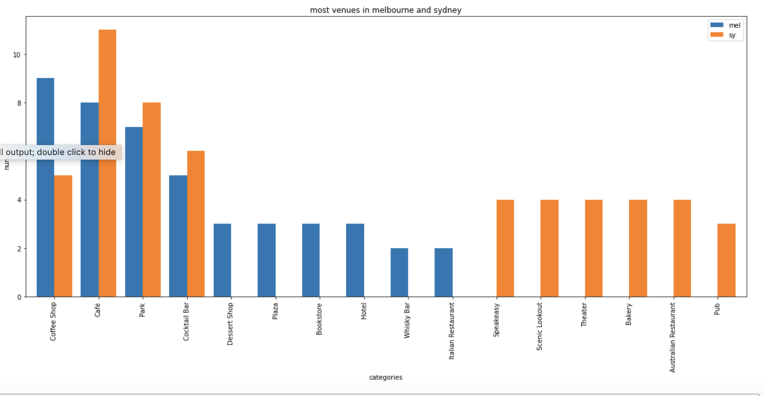
methodology

Slide 4
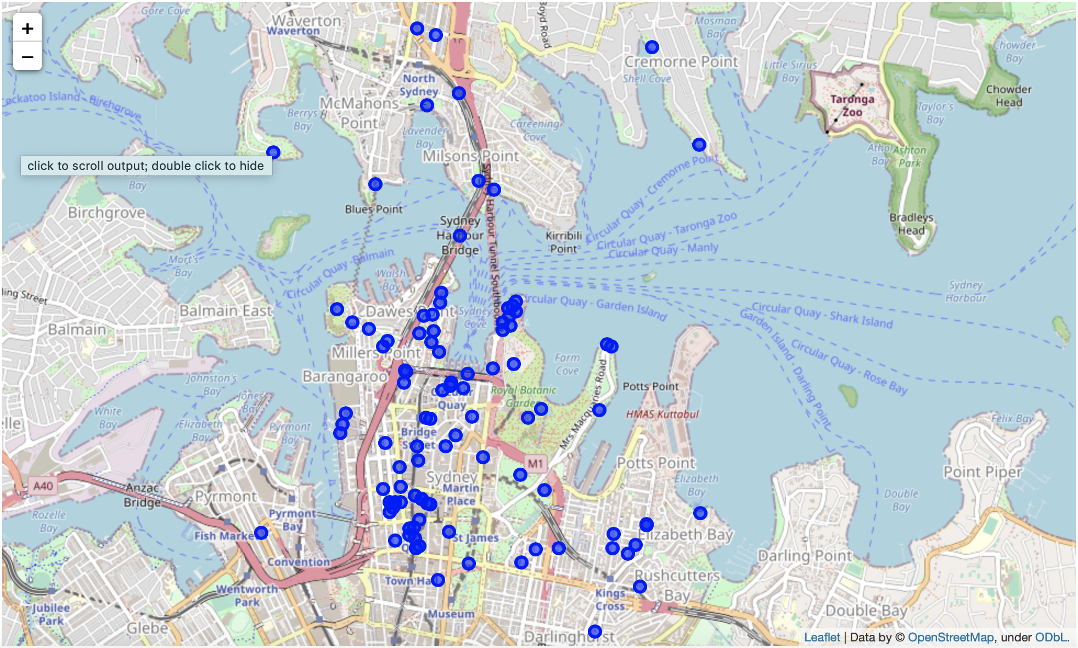
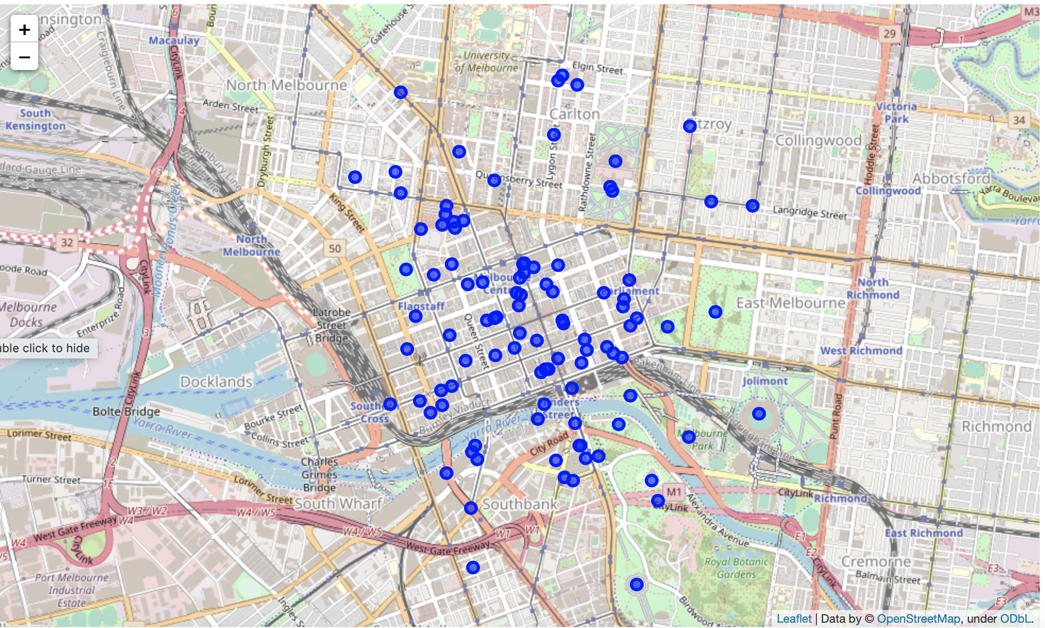
visualization

Slide 5
conclusion
venues categories
geographical feature

